Slide 1
Lecture 3: Planning by Dynamic Programming
Professor Shivali Dhaka

Slide 2
Outline
Introduction
Policy Evaluation
Policy Iteration
Value Iteration

Slide 3
What is Dynamic Programming?
Dynamic sequential or temporal component to the problem Programming optimising a “program”, i.e. a policy
c.f. linear programming
A method for solving complex problems By breaking them down into subproblems
Solve the subproblems
Combine solutions to subproblems

Slide 4
Requirements for Dynamic Programming
Dynamic Programming is a very general solution method for problems which have two properties:
Optimal substructure
Principle of optimality applies
Optimal solution can be decomposed into subproblems
Overlapping subproblems
Subproblems recur many times Solutions can be cached and reused
Markov decision processes satisfy both properties Bellman equation gives recursive decomposition Value function stores and reuses solutions

Slide 5
Planning by Dynamic Programming
Dynamic programming assumes full knowledge of the MDP.
It is used for planning in an MDP
For prediction:
Input: MDP (S, A, P, R, γ) and policy π
or: MRP (S, P^{π}, R^{π}, γ)
Output: value function v_{π}
Or for control:
Input: MDP (S, A, P, R, γ)
Output: optimal value function v∗
and: optimal policy π∗

Slide 6
Other Applications of Dynamic Programming
Dynamic programming is used to solve many other problems, e.g.
Scheduling algorithms
String algorithms (e.g. sequence alignment) Graph algorithms (e.g. shortest path algorithms) Graphical models (e.g. Viterbi algorithm) Bioinformatics (e.g. lattice models)

Slide 7
Iterative Policy Evaluation
Problem: evaluate a given policy π
Solution: iterative application of Bellman expectation backup
v₁ → v₂ → ... → v_{π}
Using synchronous backups, At each iteration k + 1 For all states s ∈ S
Update v_{k+1}(s) from v_{k} (s') where s' is a successor state of s
We will discuss asynchronous backups later
Convergence to v_{π} will be proven at the end of the lecture

Slide 8
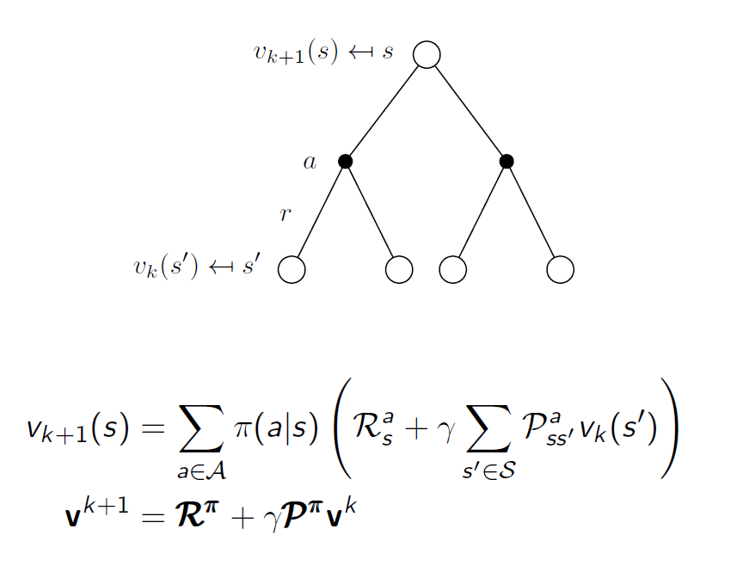
Iterative Policy Evaluation (2)

Slide 9
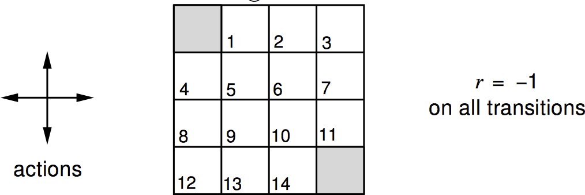
Evaluating a Random Policy in the Small Gridworld
Undiscounted episodic MDP (γ = 1) Nonterminal states 1, ..., 14
One terminal state (shown twice as shaded squares) Actions leading out of the grid leave state unchanged Reward is −1 until the terminal state is reached Agent follows uniform random policy
π(n|·) = π(e|·) = π(s|·) = π(w|·) = 0.25

Slide 10
Iterative Policy Evaluation in Small Gridworld
v_{k} for the Random Policy
V_{k}
Greedy Policy
w.r.t. v_{k}
V_{k}
0.0 | 0.0 | 0.0 | 0.0
0.0 | 0.0 | 0.0 | 0.0
0.0 | 0.0 | 0.0 | 0.0
0.0 | 0.0 | 0.0 | 0.0
k = 0
random
policy
0.0 | -1.0 | -1.0 | -1.0
-1.0 | -1.0 | -1.0 | -1.0
-1.0 | -1.0 | -1.0 | -1.0
-1.0 | -1.0 | -1.0 | 0.0
k = 1
0.0 | -1.7 | -2.0 | -2.0
-1.7 | -2.0 | -2.0 | -2.0
-2.0 | -2.0 | -2.0 | -1.7
-2.0 | -2.0 | -1.7 | 0.0
k = 2

Slide 11
Iterative Policy Evaluation in Small Gridworld (2)
0.0 | -2.4 | -2.9 | -3.0
-2.4 | -2.9 | -3.0 | -2.9
-2.9 | -3.0 | -2.9 | -2.4
-3.0 | -2.9 | -2.4 | 0.0
k = 3
0.0 | -6.1 | -8.4 | -9.0
-6.1 | -7.7 | -8.4 | -8.4
-8.4 | -8.4 | -7.7 | -6.1
-9.0 | -8.4 | -6.1 | 0.0
k = 10
optimal
policy
0.0 | -14. | -20. | -22.
-14. | -18. | -20. | -20.
-20. | -20. | -18. | -14.
-22. | -20. | -14. | 0.0
k = ∞
°

Slide 12
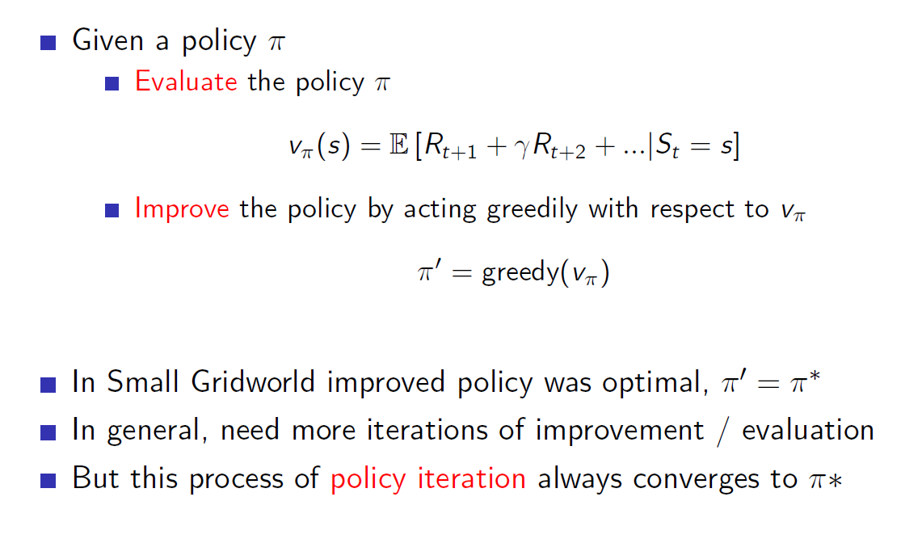
How to Improve a Policy

Slide 13
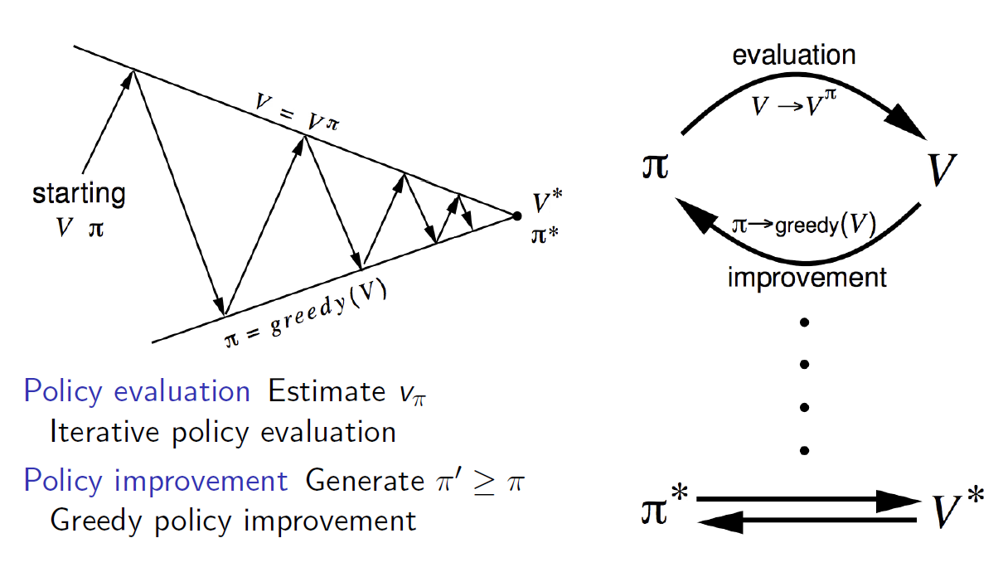
Policy Iteration

Slide 14


Jack’s Car Rental
States: Two locations, maximum of 20 cars at each Actions: Move up to 5 cars between locations overnight Reward: $10 for each car rented (must be available) Transitions: Cars returned and requested randomly
n
Poisson distribution, n returns/requests with prob
1st location: average requests = 3, average returns = 3
2nd location: average requests = 4, average returns = 2

Slide 15
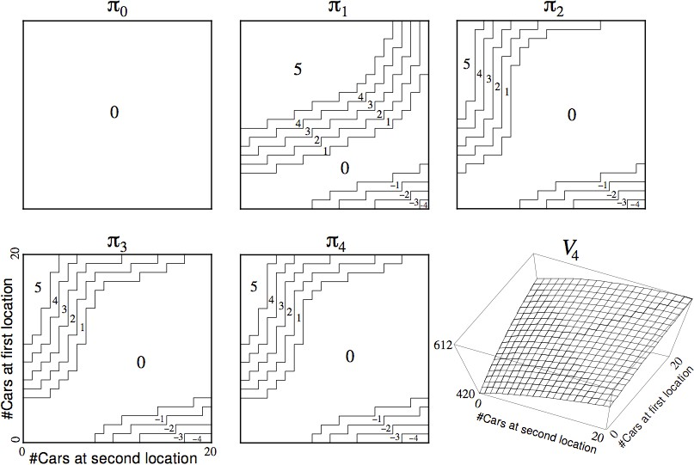
Policy Iteration in Jack’s Car Rental

Slide 16
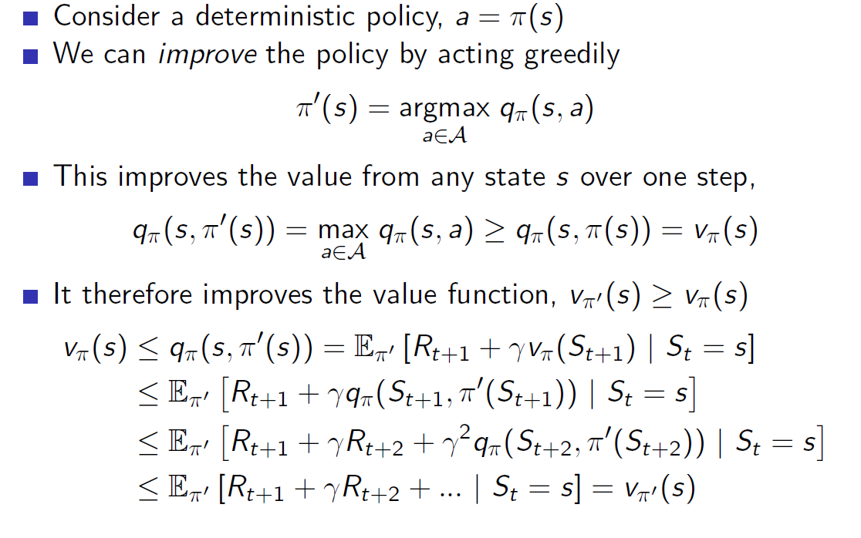
Policy Improvement

Slide 17
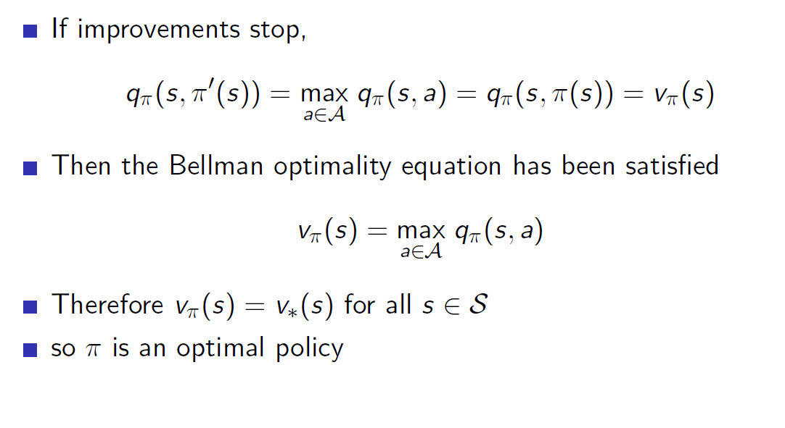
Policy Improvement (2)

Slide 18
Modified Policy Iteration
Does policy evaluation need to converge to v_{π} ?
Or should we introduce a stopping condition
e.g. s-convergence of value function
Or simply stop after k iterations of iterative policy evaluation?
For example, in the small gridworld k = 3 was sufficient to achieve optimal policy
Why not update policy every iteration? i.e. stop after k = 1
This is equivalent to value iteration (next section)

Slide 19
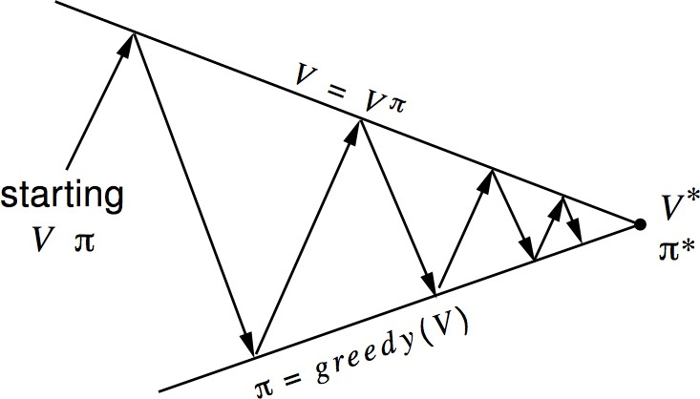
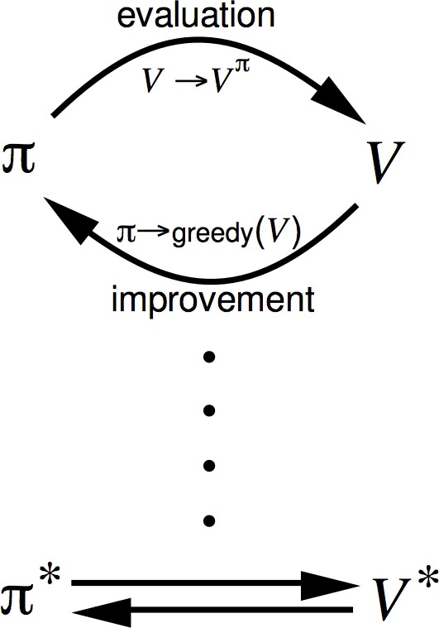
Generalised Policy Iteration
Policy evaluation Estimate v_{π}
Anypolicy evaluation algorithm
Policy improvement Generate π^{j} ≥ π
Anypolicy improvement algorithm

Slide 20
Principle of Optimality
Any optimal policy can be subdivided into two components: An optimal first action A∗
Followed by an optimal policy from successor state S^{j}
Theorem (Principle of Optimality)
A policy π(a|s) achieves the optimal value from state s, v_{π} (s) = v∗(s), if and only if
For any state s^{j} reachable from s
π achieves the optimal value from state s^{j}, v_{π} (s^{j}) = v∗(s^{j})

Slide 21
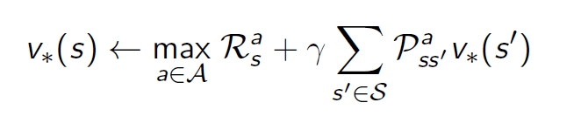
Deterministic Value Iteration
If we know the solution to subproblems v∗(s^{j})
Then solution v∗(s) can be found by one-step lookahead
The idea of value iteration is to apply these updates iteratively Intuition: start with final rewards and work backwards
Still works with loopy, stochastic MDPs

Slide 22
Example: Shortest Path
g
0 | 0 | 0 | 0
0 | 0 | 0 | 0
0 | 0 | 0 | 0
0 | 0 | 0 | 0
0 | -1 | -1 | -1
-1 | -1 | -1 | -1
-1 | -1 | -1 | -1
-1 | -1 | -1 | -1
0 | -1 | -2 | -2
-1 | -2 | -2 | -2
-2 | -2 | -2 | -2
-2 | -2 | -2 | -2
Problem
V₁
V₂
V₃
0 | -1 | -2 | -3
-1 | -2 | -3 | -3
-2 | -3 | -3 | -3
-3 | -3 | -3 | -3
0 | -1 | -2 | -3
-1 | -2 | -3 | -4
-2 | -3 | -4 | -4
-3 | -4 | -4 | -4
0 | -1 | -2 | -3
-1 | -2 | -3 | -4
-2 | -3 | -4 | -5
-3 | -4 | -5 | -5
0 | -1 | -2 | -3
-1 | -2 | -3 | -4
-2 | -3 | -4 | -5
-3 | -4 | -5 | -6
V₄
V₅
V₆
V₇

Slide 23
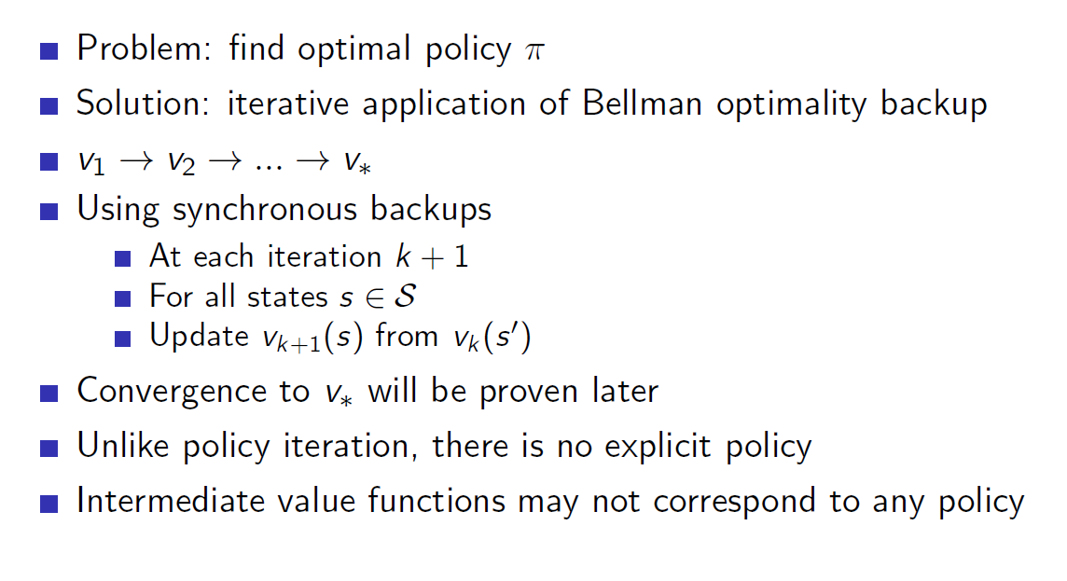
Value Iteration

Slide 24
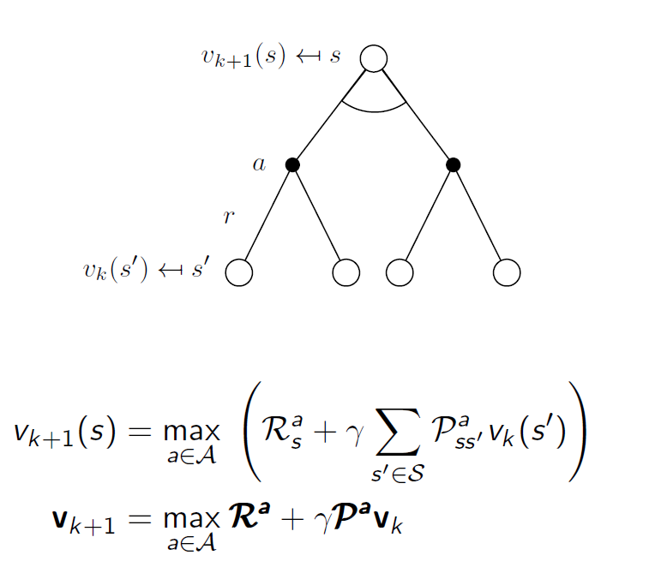
Value Iteration (2)

Slide 25
Synchronous Dynamic Programming Algorithms
Problem | Bellman Equation | Algorithm
Prediction | Bellman Expectation Equation | Iterative Policy Evaluation
Control | Bellman Expectation Equation + Greedy Policy Improvement | Policy Iteration
Control | Bellman Optimality Equation | Value Iteration
Algorithms are based on state-value function v_{π} (s) or v∗(s) Complexity O(mn²) per iteration, for m actions and n states Could also apply to action-value function q_{π} (s, a) or q∗(s, a) Complexity O(m²n²) per iteration

